Slide 1
CALVE HEATER
DETAILED ESCRIPTION

Slide 2
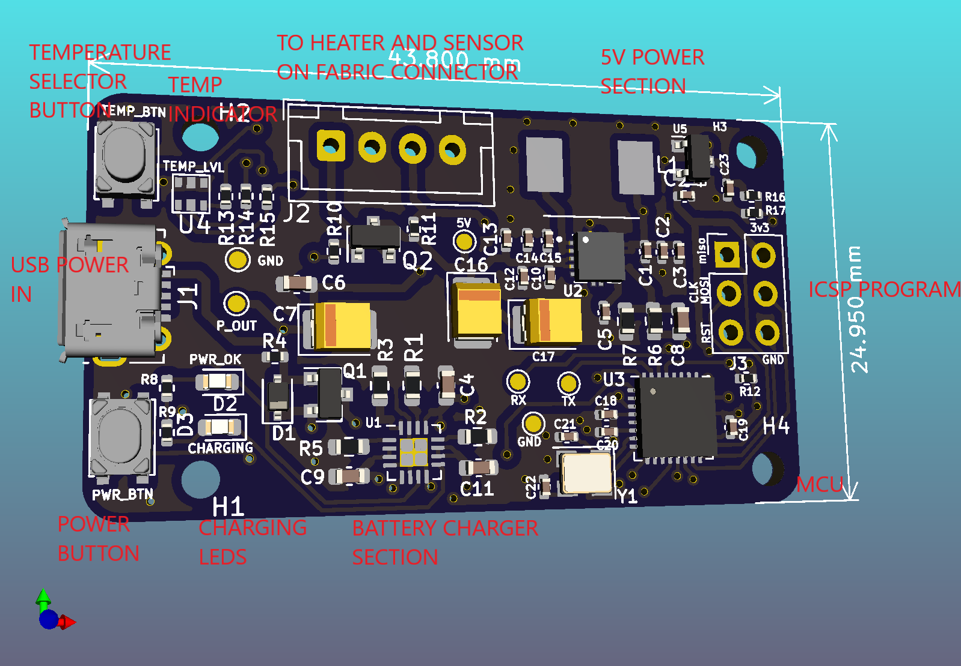
PCB

Slide 3
PCB
The USB port acts as the charging input. When charging the charging LEDs, green and Red are on. When done with charging, Only the red LED is on. (note the location of the charging LEDs.
The Power button is used to turn on and off the device. Press once to turn on and long Press for 1 sec to turn off.
Temperature selector button is used to set the temperature level for which the heater is to operate. Defult is 40 deg. Press once to increase the level to 44deg then again to 48 deg. Once at maximum pressing the button returns t=the temperature setting to the default 40deg.

Slide 4
PCB
The connector labeled J2 is used to connect the heater coil/element located off the board(in the fabric). As well as the temperature sensor. This allows the heater and sensor to be plugged in and removeable at will and depending on use.
ICSP programmer are used to load the software to the board MCU as per the instruction in the github link.
The MCU controls the heating of the board accordingly ensuring that it measures the temperature in of the heater using the connected sensor and maintains the heat as desired. It ensures that the desired temperature and over temperature conditions do not occur. this MCU control/drives the heater.
The MCU as well reads the user settings and manages the LEDS indicators that inform the user.

Slide 5
PCB
EG when the battery is Low, the MCU causes the red LED to blink at a rate of 1 sec to indicate need for charging.
Temperature indicator LED are 3 which will indicate the 3 temperature setting selected by the user:
Green = 40deg low
Blue = 44deg medium
Red = 48deg high

Slide 6
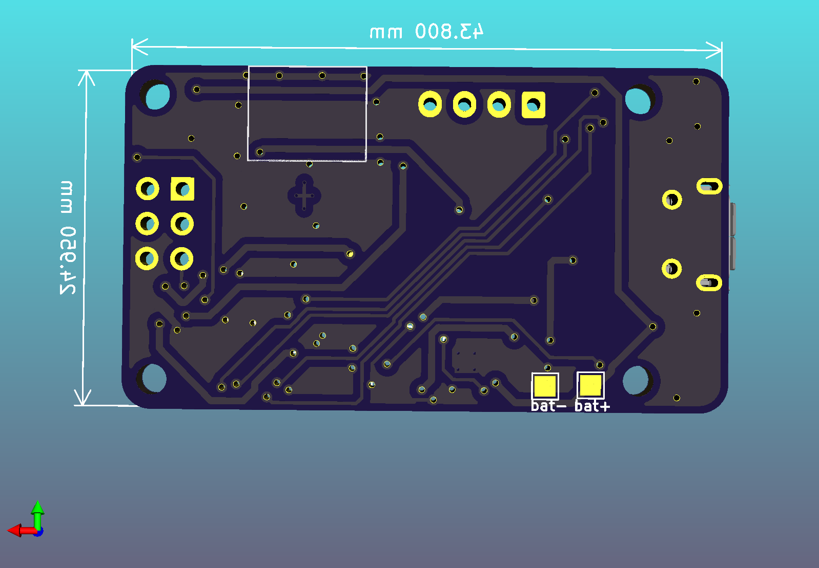
PCB

Slide 7
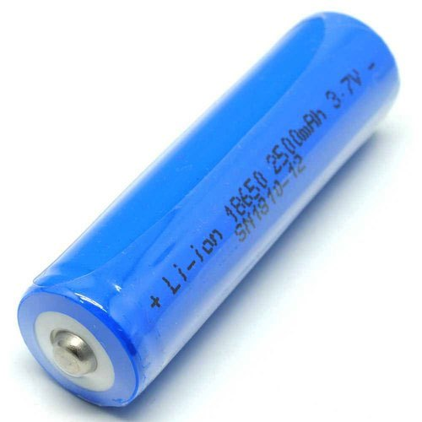
BATTERY
He battery is connected to the PCB via the bat+ and bat- pads shown above. These two terminal allow flexibility of connection and placement of the battery on any angle in a mechanical package.
Battery type for use: https://www.indiamart.com/proddetail/lithium-ion-batteries-3-7v-2500mah-10433305048.html

Slide 8
BATTERY LIFE
The design is kept simple and efficient as possible using low quiescent IC and MCUs. The heater power range is as well low with a about 100mA current consumption. Thus the total current consumption range for all the equipment in the PCB is about
100 heater + 100 MCU+ 50 Loses=250mA
Battery capacity = 2500
Total Hours of use = 2500/250 = 10Hrs approximate battery life.

Slide 9
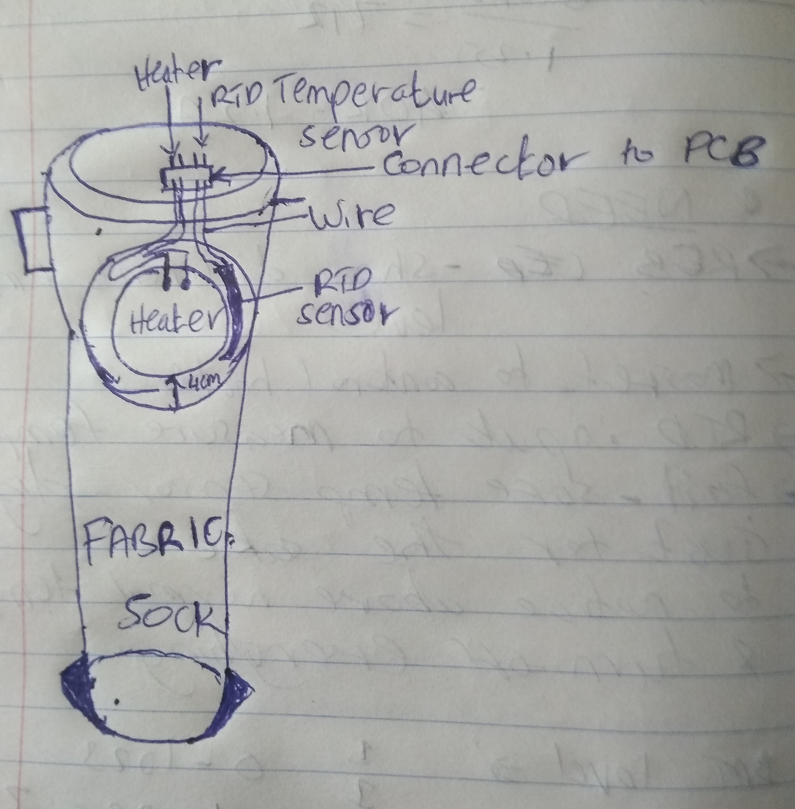
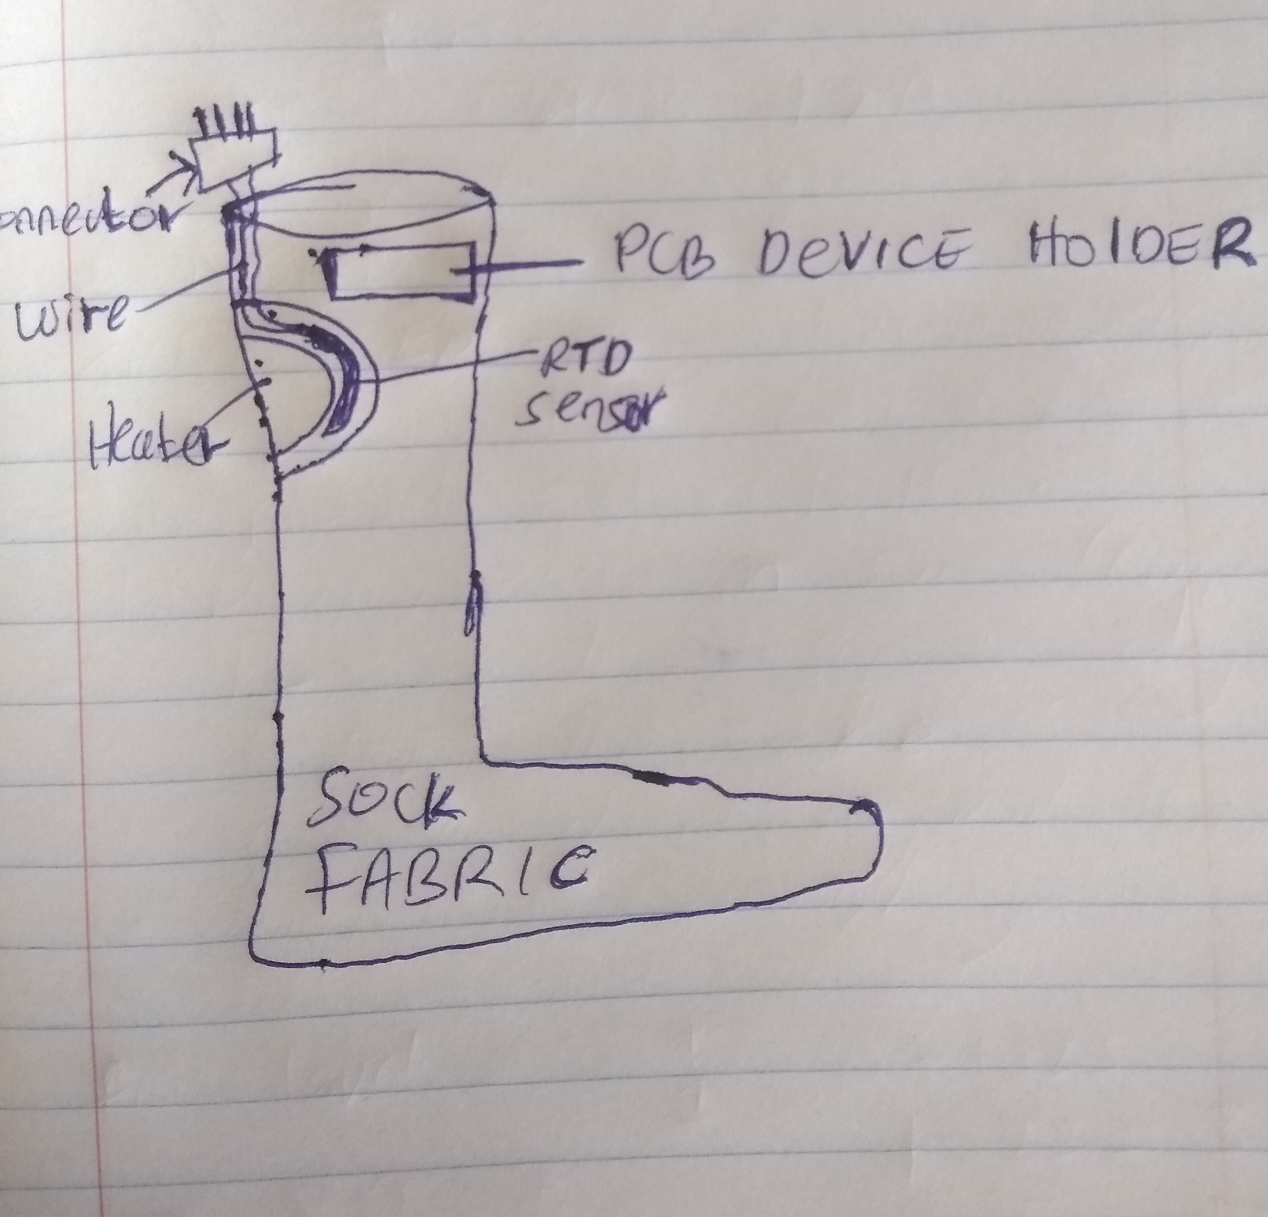
HEATER LAYOUT SKETCH

Slide 10
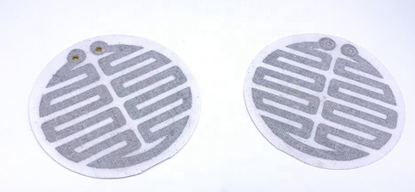
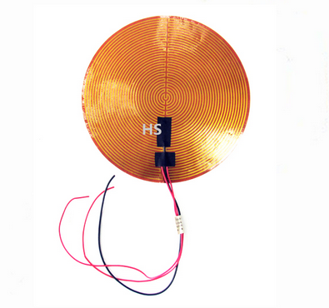
HEATER SELECTION
COTTON TYPE HEATER LINK : https://www.alibaba.com/product-detail/Thermostatic-electric-carbon-fiber-heating-element_62302051301.html?spm=a2700.wholesale.0.0.c5e0bc1cLrvEdd
Flexible heater selection 2: https://www.alibaba.com/product-detail/High-Temperature-Flexible-Ployimide-PI-Film_60627303766.html

Slide 11
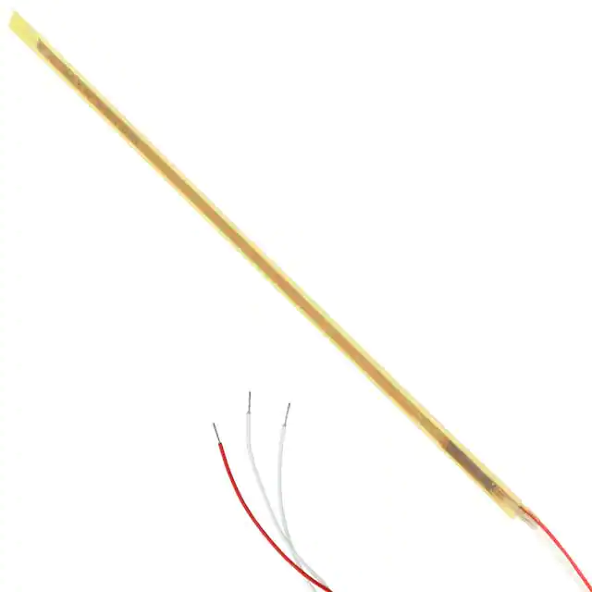
TEMPERATURE SENSOR
https://www.digikey.com/en/products/detail/te-connectivity-measurement-specialties/R-8203/5277360
Flexible and bendable surface which is easy to integrate/place in a fabric

Slide 12
SAFETY
The product features a removeable PCB device which can there fore be kept odd any harmful conditions e.g. during washing.
The heater elements by nature of there design are well insulated and suited to be used in fabrics and thus have good insulation resistant to corrosion and able to be bent and folded according to best practice in any electrically heated fabrics.
The RTD sensor is well insulated as well and carries micro amperes of current which cannot lead to any form of sensation or shock to the user incase of any leakages. Making this product perfectly safe for use.

Slide 13
CONCLUSION
The product design utilizes existing components and materials that a re cheaply available making it affordable.
The PCB design is of a small form factor and flexible thus making it very adaptable and to any changing conditions and uses.
The battery life in this design is optimized via design of efficient software, hardware components and the heating process.
Safety is integrated in the process from firmware design to prevent over temperature conditions and proper selection of heating and sensor elements.
Rechargeable battery and proper indication has been achieved in the design as well.

